Slide 1
Excavations and Trenching
29 CFR 1926 Subpart P
Presented by:
Notes:
Updated: 05/13/24
The information in this presentation is provided voluntarily by the N.C. Department of Labor, Education Training and Technical Assistance Bureau as a public service and is made available in good faith. This presentation is designed to assist trainers conducting OSHA outreach training for workers. Since workers are the target audience, this presentation emphasizes hazard identification, avoidance, and control – not standards. No attempt has been made to treat the topic exhaustively. It is essential that trainers tailor their presentations to the needs and understanding of their audience.
The information and advice provided on this Site and on Linked Sites is provided solely on the basis that users will be responsible for making their own assessment of the matters discussed herein and are advised to verify all relevant representations, statements, and information.
This presentation is not a substitute for any of the provisions of the Occupational Safety and Health Act of North Carolina or for any standards issued by the N.C. Department of Labor. Mention of trade names, commercial products, or organizations does not imply endorsement by the N.C. Department of Labor.

Slide 2
Objectives
1926 Subpart P
In this course, we will discuss the following:
  Excavations and Trenching: Subpart P
    1926.650 - Scope, application, and definitions applicable to this subpart
    1926.651 - Specific excavation requirements
    1926.652 - Requirements for protective systems

Slide 3
Subpart P - Appendices
1926 Subpart P
Appendix A - Soil Classification
Appendix B - Sloping and Benching
Appendix C - Timber Shoring for Trenches
Appendix D - Aluminum Hydraulic Shoring
Appendix E - Alternatives to Timber Shoring
Appendix F - Selection of Protective Systems

Slide 4
Definitions
1926.650(b)
Excavation
  Man-made cut, cavity, trench, or depression in an earth surface, formed by earth removal
Trench
  Narrow excavation
  Depth is greater than the width, but not wider than 15 feet
Shield (Shield system)
  Structure able to withstand a cave-in and protect employees

Slide 5
Definitions
1926.650(b)
Shoring (Shoring system)
  Structure that supports the sides of an excavation and protects against cave-ins
Sloping (Sloping system)
  Technique that employs a specific angle of incline on the sides of the excavation
Tabulated Data
  Tables and charts approved by a registered professional engineer (RPE) and used to design and construct a protective system

Slide 6
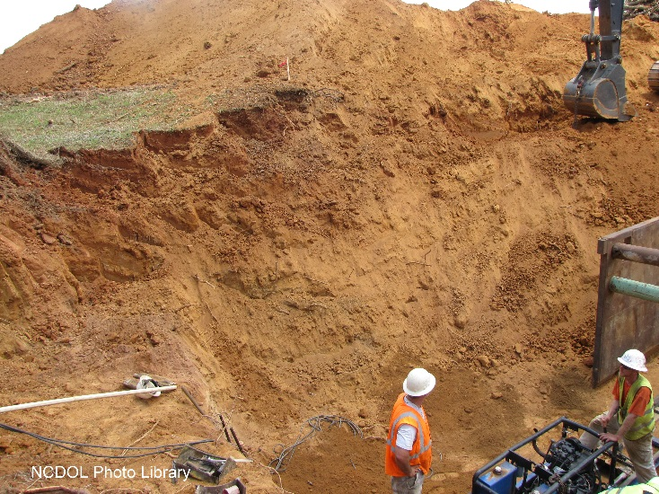
Definitions
1926 Subpart P, Appendix A
Unconfined Compressive Strength
  Load per unit area at which soil will fail in compression. It can be determined by laboratory testing, or estimated in the field using a pocket penetrometer, by thumb penetration tests, or by other methods.

Slide 7
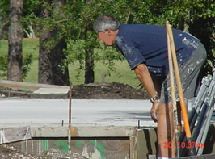
Definitions
1926.650(b)
Competent person
  Authority to take prompt corrective measures to eliminate existing and predictable hazards and to stop work when required
  Ability to detect:
    Conditions that could result in cave-ins
    Failures in protective systems
    Hazardous atmospheres
    Other hazards including those associated with confined spaces
  Should have training, experience and/or knowledge of:
    Soil classification
    Use of protective systems
    Requirements of the standard
NCDOL Photo Library

Slide 8
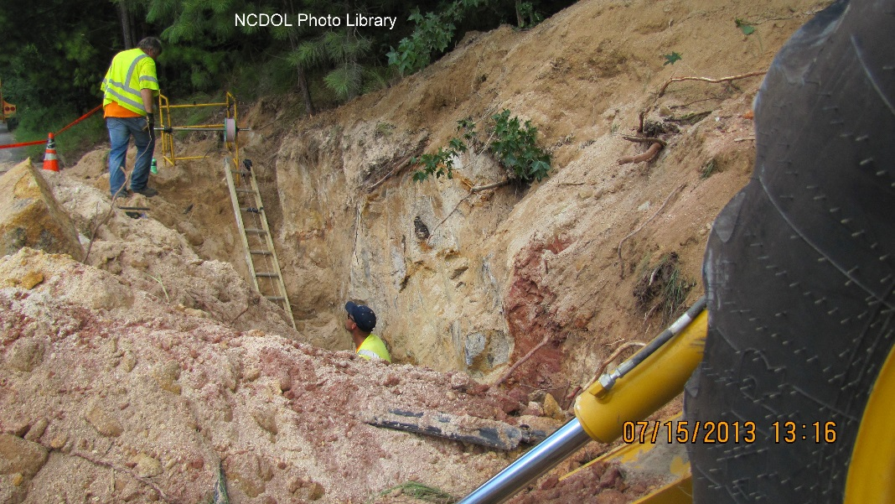
Weight of Soil
Weight of soil varies with type and moisture content
One cubic foot weighs 110 pounds to 140 pounds
One cubic yard (27 cubic feet) of soil can weigh more than 3,000 pounds

Slide 9
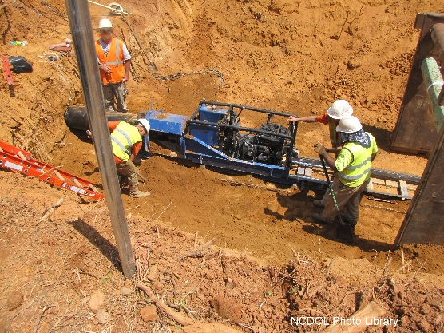
Excavation Hazards
Cave-ins are the greatest risk
Other hazards include:
  Asphyxiation due to lack of oxygen
  Inhalation of toxic materials/fumes
  Water accumulation
  Machinery moving near edge of excavation causing a collapse
  Severing underground utility lines
  Falls

Slide 10
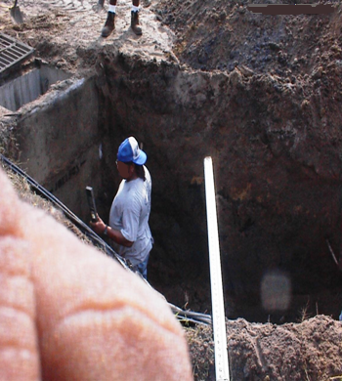
Injury and Death
Excavating is one of the most hazardous construction operations
Most accidents occur in trenches 5 - 15 feet deep
Usually, no warning before
a cave-in
NCDOL Photo Library

Slide 11
Specific Excavation Requirements
(a) Surface encumbrances
(b) Underground installations
(c) Access and egress
(d) Exposure to vehicular traffic
(e) Exposure to falling loads
(f) Warning system for mobile equipment
(g) Hazardous atmospheres

Slide 12
Specific Excavation Requirements
(h) Protection from hazards associated with
water accumulation
(i) Stability of adjacent structures
(j) Protection of employees from loose rock or
soil
(k) Inspections
(l) Walkways

Slide 13
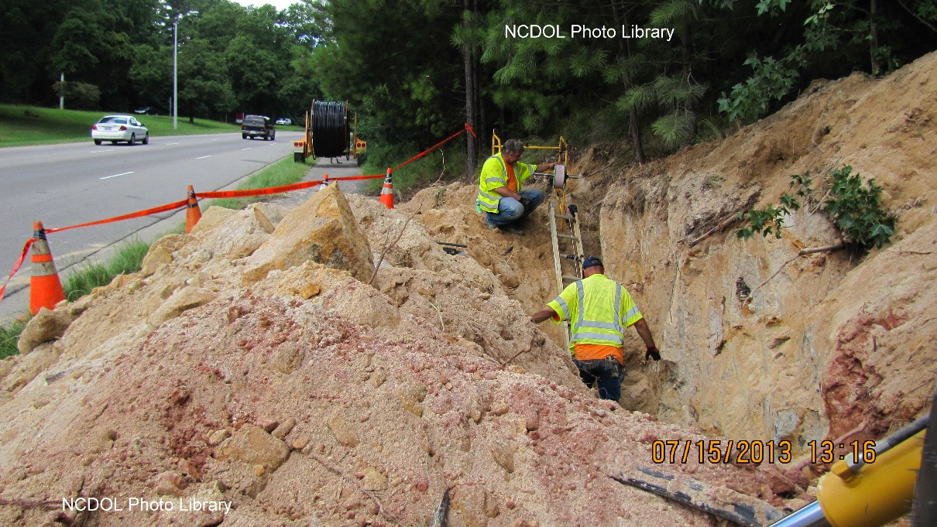
Surface Encumbrances
1926.651(a)
All surface encumbrances that create a hazard to employees must be removed or supported to safeguard employees

Slide 14
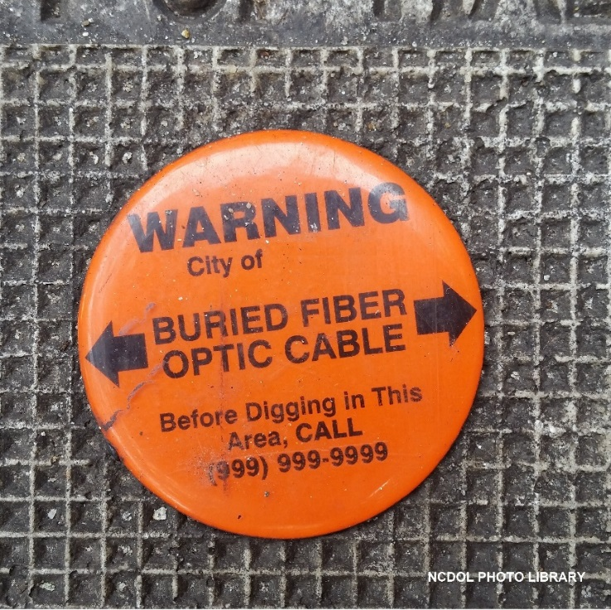
Underground Installations
1926.651(b)(1)
Estimated location of utility installations (sewer, telephone, fuel, electric, water lines) must be determined prior to opening an excavation

Slide 15
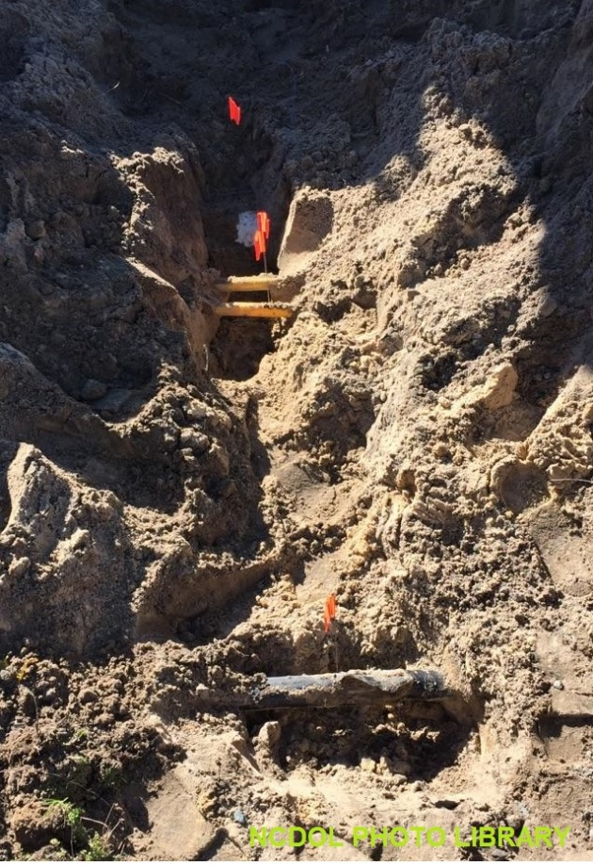
Underground Installations
1926.651(b)(2)
When utility companies or owners cannot respond to a request to locate underground utility installations within 72 hours (NC)
  Employer may proceed with caution, provided detection equipment, or other acceptable means, is used to locate utility installations
  Use ‘pot-holing’ technique

Slide 16

Underground Installations
1926.651(b)(3)
Exact location of underground installations must be determined by safe and acceptable means
Underground installations must be protected, supported or removed as necessary to safeguard employees

Slide 17
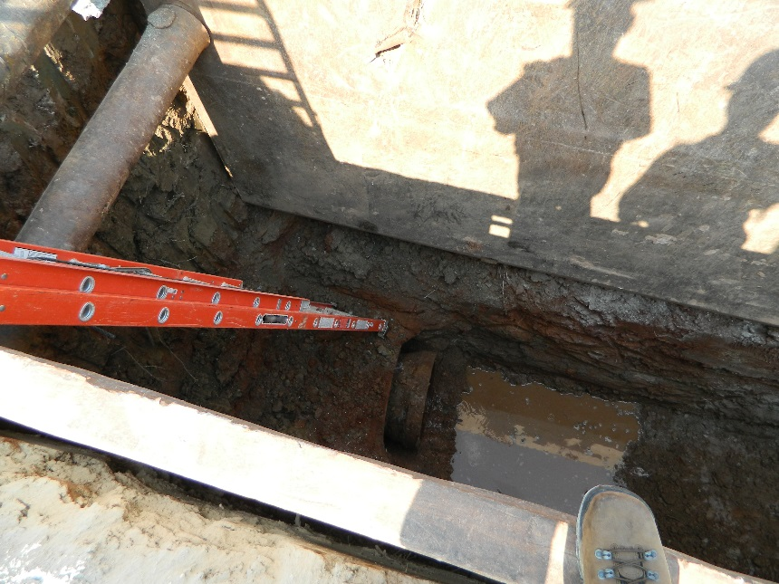
Egress - Trench Excavation
1926.651(c)(2)
Stairway, ladder, ramp, or other safe means of egress must be located in trench
Required if trench 4 feet or more in depth
Lateral travel distance no more than 25 feet
NCDOL Photo Library

Slide 18
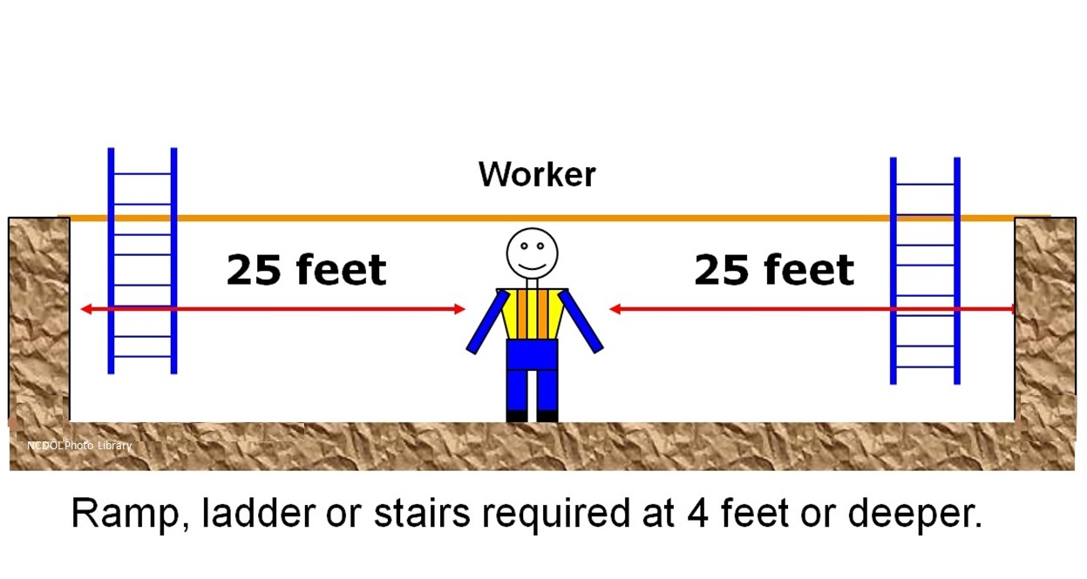
Egress - Trench Excavation
1926.651(c)(2)
NCDOL Photo Library

Slide 19
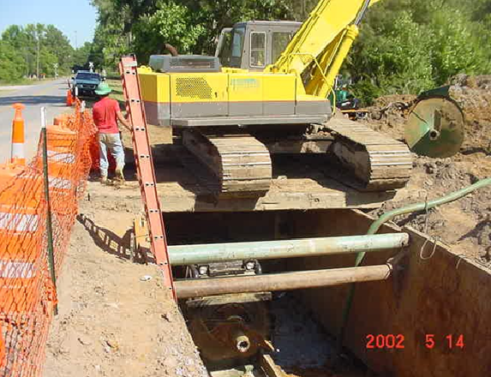
Egress - Trench Excavation
Is this correct?
NCDOL Photo Library

Slide 20
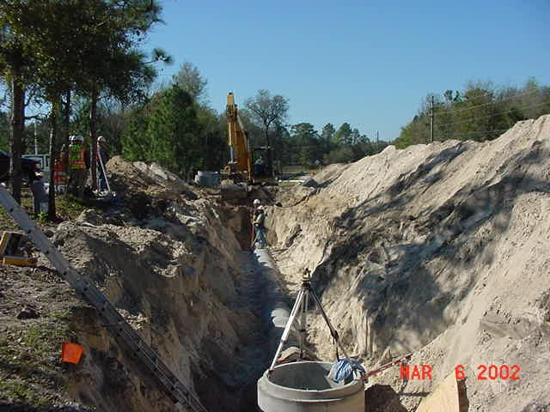
Exposure to Falling Loads
1926.651(e)
Employees must not be permitted to work under loads handled by lifting or digging equipment
NCDOL Photo Library

Slide 21
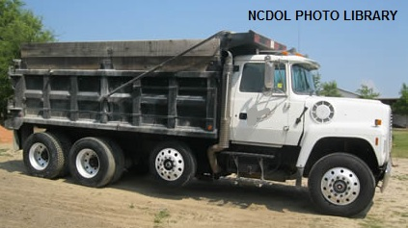
Exposure to Falling Loads
1926.651(e)
Stand away from equipment that is being loaded or unloaded
Equipment operators may stay in their equipment
during loading and unloading if equipment has proper cab shield or canopy

Slide 22
Warning System - Mobile Equipment
1926.651(f)
Mobile equipment operated adjacent to excavation and operator cannot see edge of the excavation:
  Warning system must be utilized
    Barricades
    Hand or mechanical signals
    Stop logs
NCDOL Photo Library

Slide 23
Hazardous Atmospheres
1926.651(g)(1)
Where a hazardous atmosphere exists or could reasonably be expected to exist, testing shall be conducted before employees enter the trench and regularly thereafter
  Less than 19.5% or more than 23.5% oxygen
  A combustible gas concentration greater than 20% of the Lower Flammable Limit (LFL)
  Concentrations of hazardous substances that exceed OSHA’s Permissible Exposure Limits (PEL)

Slide 24
Hazardous Atmospheres
1926.651(g)(1)
Test at 4 feet if suspected
  Lower explosive limit (LEL)
  Oxygen
  Carbon monoxide
  Hydrogen sulfide
  Petroleum
  Other toxics
NCDOL Photo Library

Slide 25
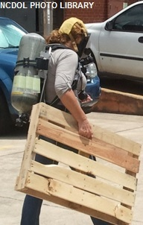
Emergency Rescue Equipment
1926.651(g)(2)(i)
Emergency rescue equipment must be readily available where hazardous atmospheric conditions exist or expected to develop during work
  Breathing apparatus
  Safety harness and line
  Basket stretcher

Slide 26
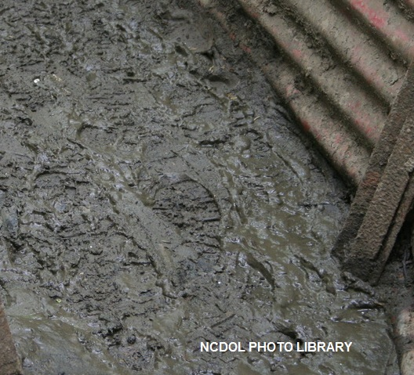
Water Accumulation
1926.651(h)
Employees must not work in excavations where there is accumulated water, or where water is accumulating
Unless precautions taken to protect workers:
  Water removal to control level of water
  Special support or shield systems
Excavations subject to runoff from
heavy rains require an inspection
by a competent person

Slide 27
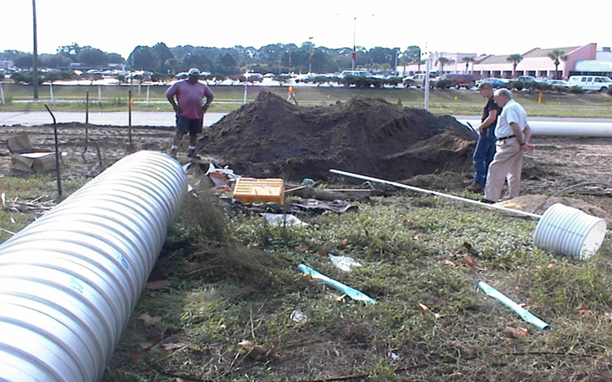
What are the hazards?
NCDOL Photo Library

Slide 28
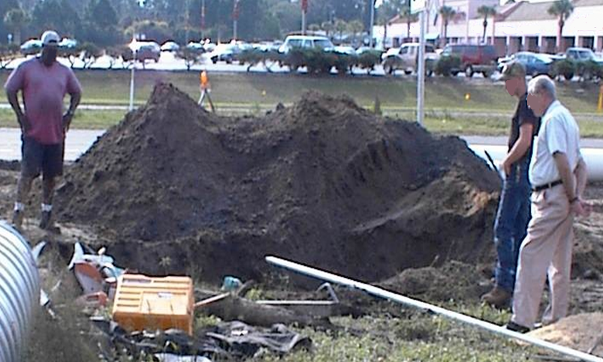
What are the hazards?
NCDOL Photo Library

Slide 29
Stability of Adjacent Buildings
1926.651(i)(1)-(2)
Support systems such as shoring, bracing, or underpinning must be provided to ensure stability of structures
Excavation below the foundation that could pose a hazard shall not be permitted except:
‘
  Underpinning provided
  Stable rock
  RPE approval

Slide 30
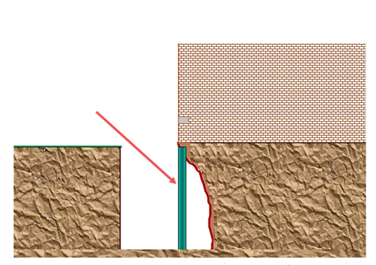
Underpinning
1926.651(i)(2)(i)
Underpinning to prevent structural failure
NCDOL Photo Library

Slide 31

Protection of Employees
1926.651(j)(1)
Adequate protection provided to protect employees from loose rock or soil that could pose a hazard by falling or rolling from an excavation face

Slide 32
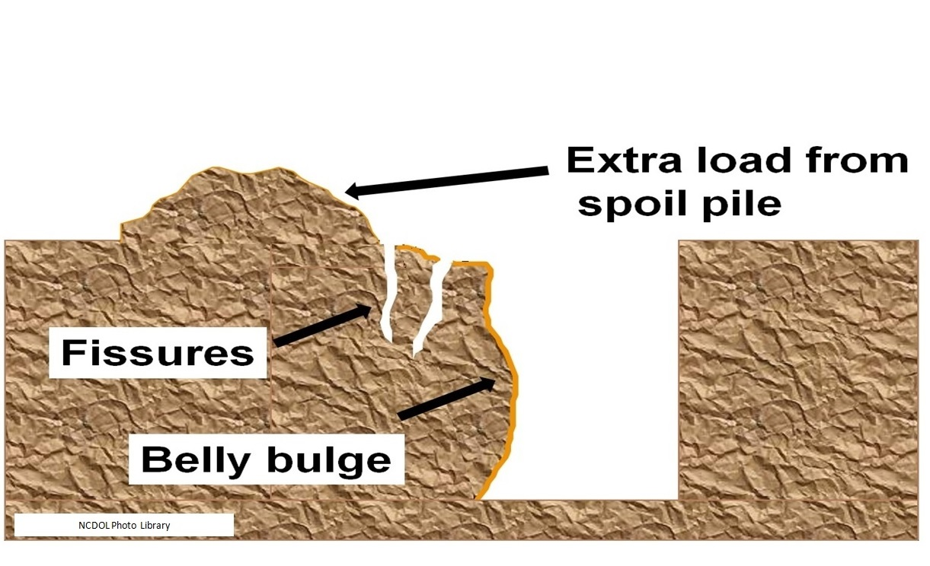
Potential Problems

Slide 33
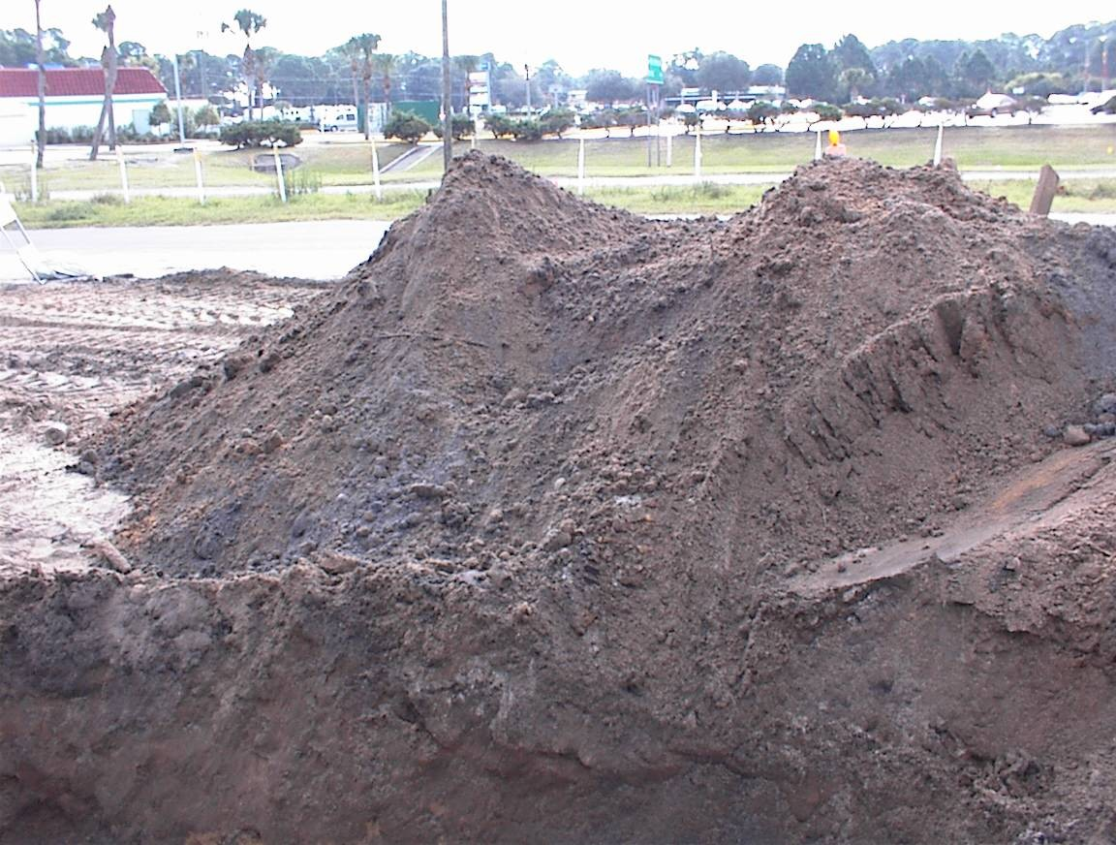
Protection of Employees
1926.651(j)(2)
Employees must be protected from equipment or materials that could fall or roll into excavations
  Materials and
  equipment must be
  kept 2 feet from edge
  of excavation or use
  retaining devices
NCDOL Photo Library

Slide 34
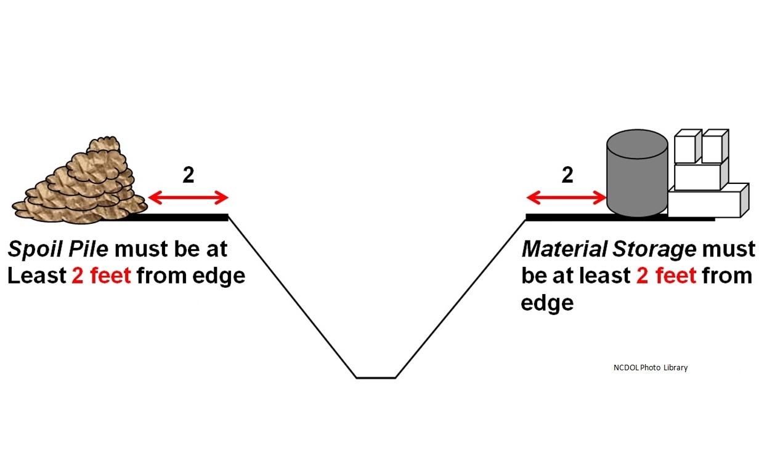
Rule: 2 Feet
1926.651(j)(2)

Slide 35
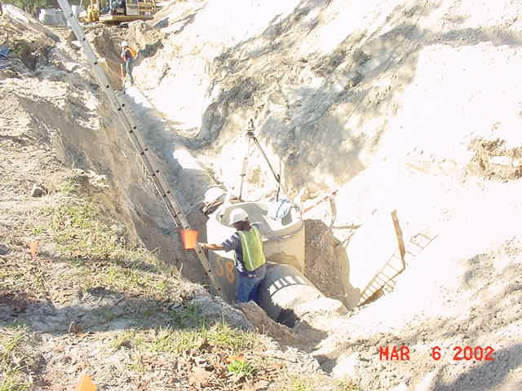
Two Feet From Edge
1926.651(j)(2)
NCDOL Photo Library

Slide 36
Inspections – Competent Person
1926.651(k)(1)
Daily
Before the start of each shift and as needed throughout the shift
After every rainstorm and other events that could increase hazards; e.g., snowstorm, windstorm, thaw, earthquake

Slide 37
Protection of Employees
1926.652(a)(1)
Employees in an excavation must be protected from cave-ins by adequate protective system
  Except when:
    Made entirely in stable rock
    Excavation is less than 5 feet
    deep and examined by
    competent person
NCDOL Photo Library
NCDOL Photo Library

Slide 38

Methods of Protection
1926.652
Sloping and benching
Shoring (spaced sheeting, closed sheeting)
Trench shield
Other occasionally
used systems

Slide 39
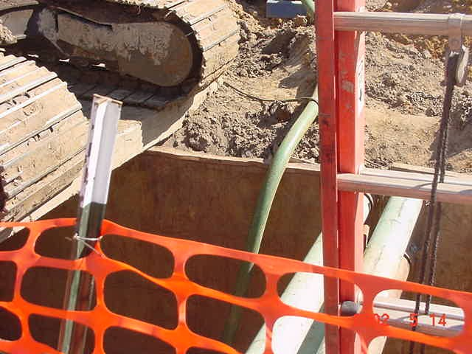
Protective Systems
1926.652(a)(2)
Protective systems shall have capacity to resist, without failure, all loads applied or transmitted to the system
NCDOL Photo Library
USDOL Photo Archive

Slide 40
Installation and Removal
1926.652(e)(1)-(2)
Support systems must be installed and removed in a manner that protects employees from cave-ins
Removal must begin at, and progress from, the bottom of the excavation
Members released slowly to note any indication of possible failure of remaining members
Excavations of material to a level not greater than 2 feet below the bottom of the support system or shield, must not be permitted

Slide 41
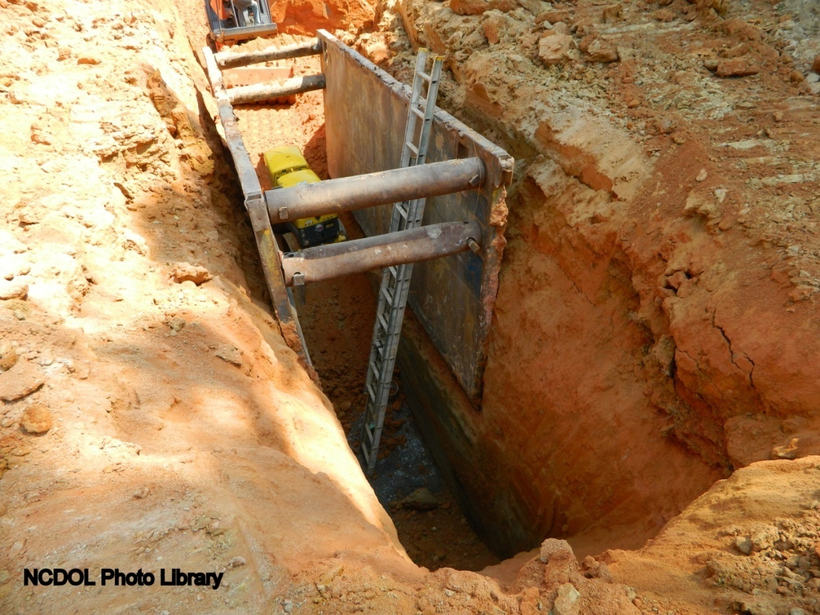
What’s the hazard?
1926.652(g)(2)

Slide 42
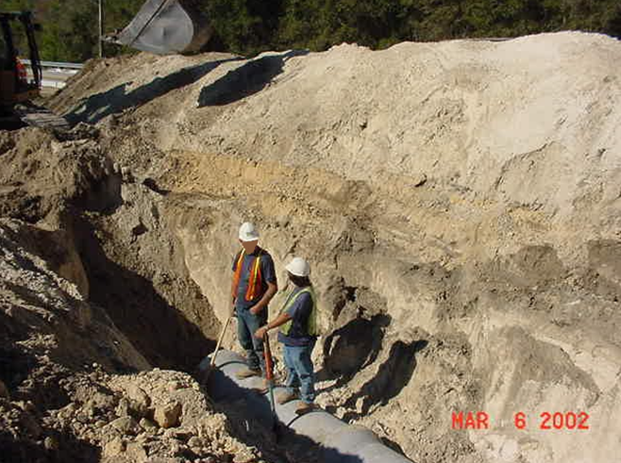
What’s the hazard?
NCDOL Photo Library

Slide 43
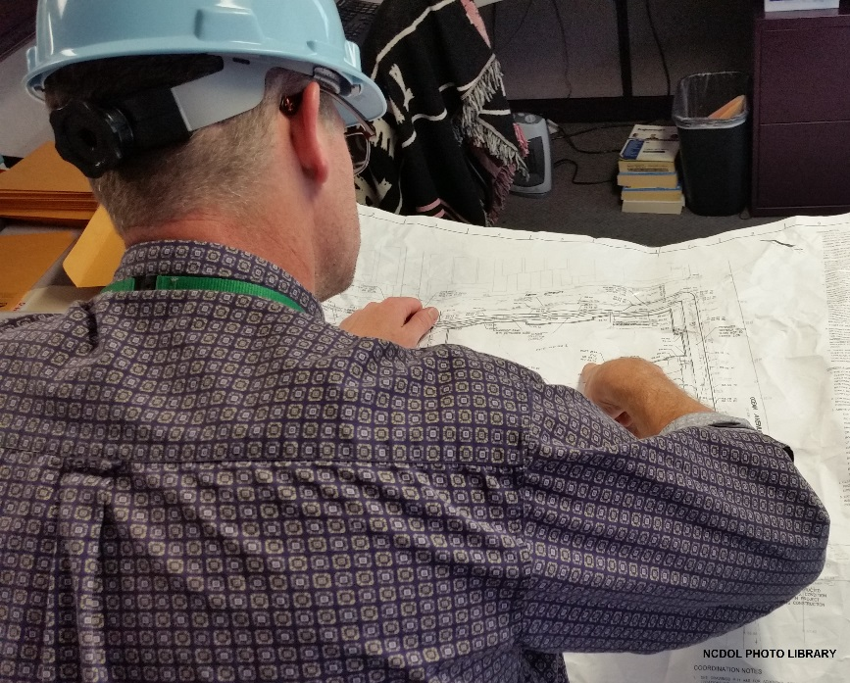
Soil Classification
Appendix A
Contains definitions
Sets forth requirements
Describes acceptable
visual and manual test
for use in classifying
soils

Slide 44
Definitions
Appendix A
Cohesive soil
  Clay, or soil with a high clay content, which has cohesive strength
    Does not crumble
    Can be excavated with vertical side slopes
    Plastic when moist
    Hard to break up when dry

Slide 45
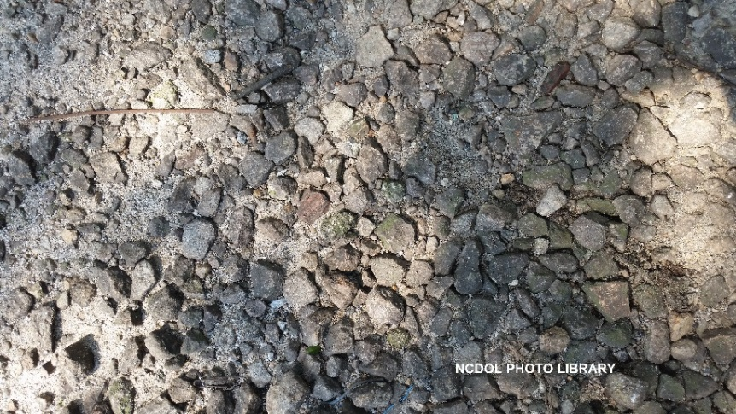
Definitions
Appendix A
Granular soil
  Gravel, sand, or silt, with little or no clay content
    No cohesive strength
    Cannot be molded when moist
    Crumbles easily when dry
  Note: Some moist granular soils exhibit
  apparent cohesion

Slide 46
Definitions
Appendix A
Unconfined compressive strength
  Load per unit area at which a soil will fail in compression
  Note: Estimated in the field by use of a pocket penetrometer, thumb penetration test, and other methods

Slide 47
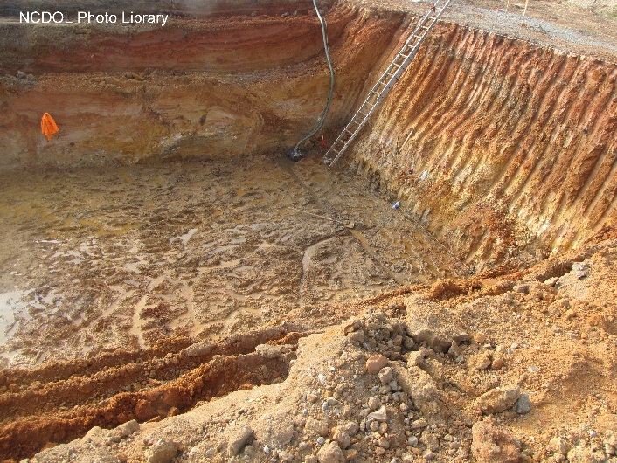
Type A Soil
Appendix A
Most stable: clay, silty clay, and hardpan
Not fissured
Not subjected to vibration of any type
Never been previously disturbed
No seeping water

Slide 48
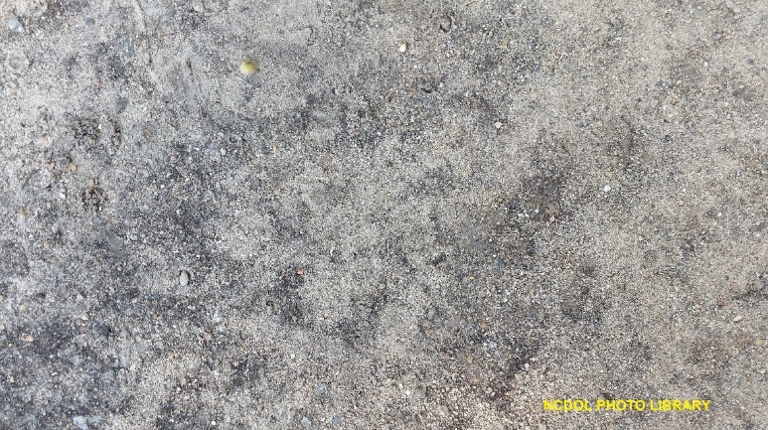
Type B Soil
Appendix A
Medium stability: silt, sandy loam, medium clay and unstable dry rock
Previously disturbed soils unless otherwise classified as Type C
Soils that meet the requirements of Type A but are fissured or subject to vibration

Slide 49
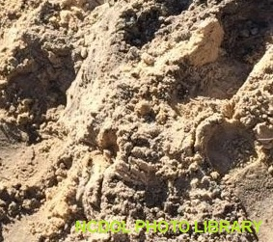
Type C Soil
Appendix A
Least stable: gravel, loamy sand, soft clay
Submerged soil or dense, heavy unstable rock
Soil from which water is freely seeping

Slide 50
Sloping and Benching
Appendix B
Scope and application - Specifications for sloping and benching when used as methods of protecting employees
Definitions
  Maximum allowable slope - Steepest incline of an excavation face that is acceptable
  Distress - Soil is in a condition where a cave-in is imminent or is likely to occur
  Short term exposure - Period of time less than or equal to 24 hours that an excavation is open

Slide 51
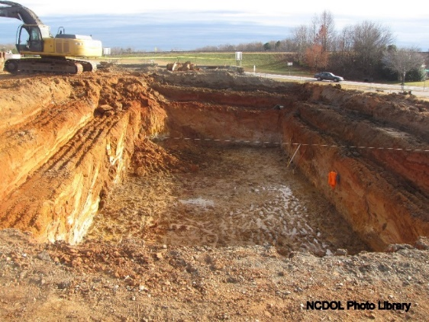
Sloping and Benching
Appendix B
Requirements
  Soil classification shall be classified
  Maximum allowable slope shall be determined
  Actual slope shall not be steeper than allowed maximum
  Configurations shall be in accordance with Figure B-1

Slide 52
Timber Shoring
Appendix C
Scope – When timber shoring is provided as a method of protection from cave-ins in trenches that do not exceed 20 feet
Soil classification (See Appendix A)
Dimensions for timber members
Arrangement examples

Slide 53
Aluminum Hydraulic Shoring
Appendix D
Scope – When aluminum hydraulic shoring is provided as a means of protection from cave-ins in trenches not to exceed 20 feet
Soil classification (See Appendix A)
Strength and properties of materials
Arrangement examples

Slide 54
Alternatives to Timber Shoring
Appendix E
Aluminum hydraulic shoring
Pneumatic/hydraulic shoring
Trench jacks (screw jacks)
Trench shields

Slide 55
Selection of Protective Systems
Appendix F
Provides a graphic summary of requirements for excavations 20 feet or less in depth
Protective systems greater than 20 feet must be designed by a Registered Professional Engineer

Slide 56
Summary
1926 Subpart P
In this course, we discussed the following:
  Excavations and Trenching: Subpart P
    1926.650 - Scope, application, and definitions applicable to this subpart
    1926.651 - Specific excavation requirements
    1926.652 - Requirements for protective systems

Slide 57
Thank You For Attending!
Final Questions?

